Slide 1
Computational Visual Perception Project Part – 2
Winter – 25/26
Name : Siddhant Vishvendu Sharma

Slide 2
1. Optical Flow & Motion Perception
We use RAFT (Recurrent All-Pairs Field Transforms) currently considered the gold standard for optical flow in the industry, we will attempt to investigate the following questions.
Q1 :Does RAFT hallucinate motion in static illusions, mirroring human vision ?
Q2 :In absence of texture on images does RAFT default to zero motion or exhibit random motion drifts ?
Q3 :Is RAFT’s response to illusions rotationally invariant, or does the flow direction rotate with image?

Slide 3
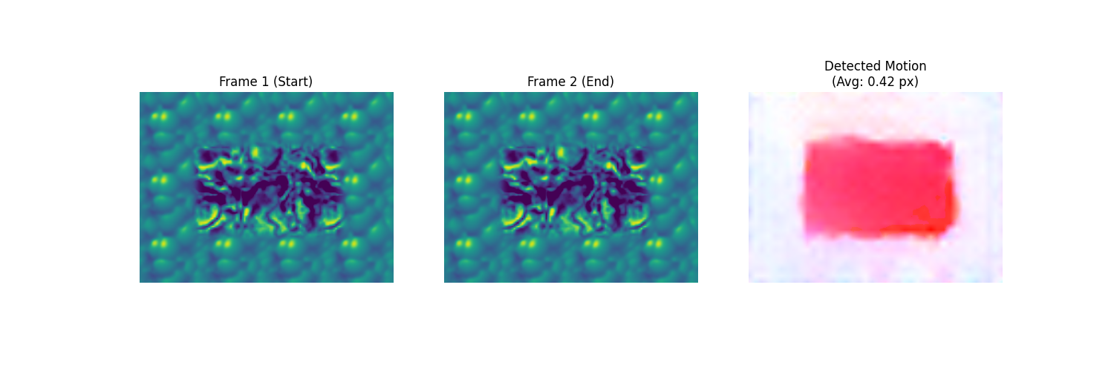
Verification of Local Implementation

Slide 4
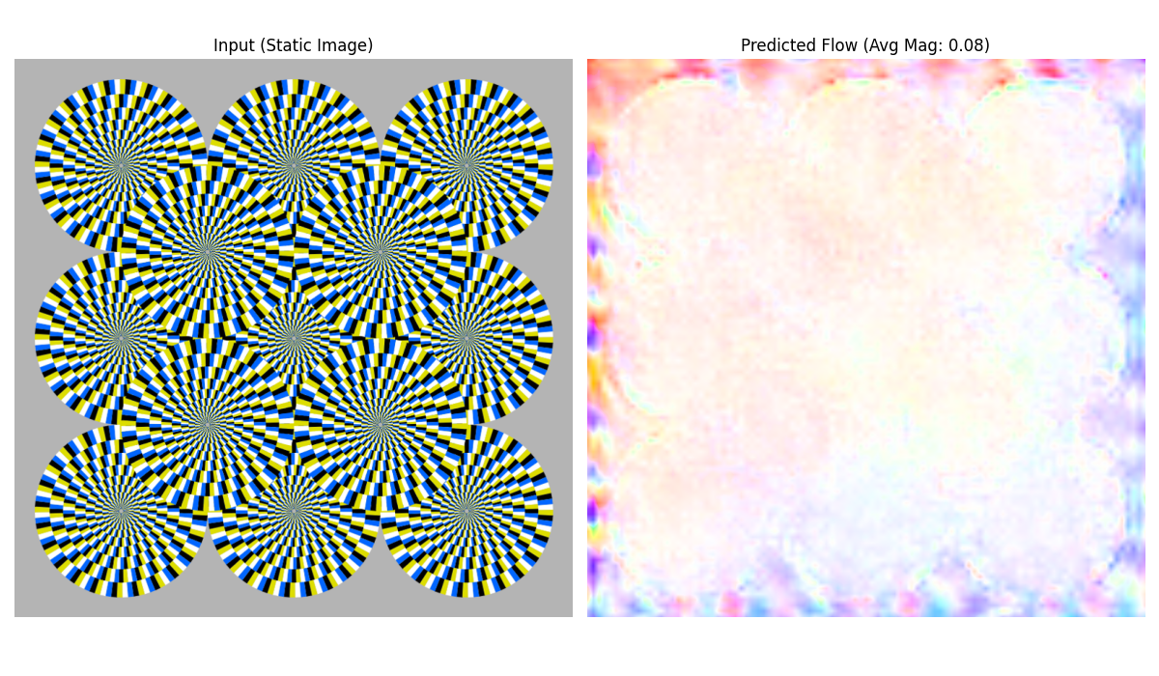
Test Case 1.1 : Rotating Snake

Slide 5
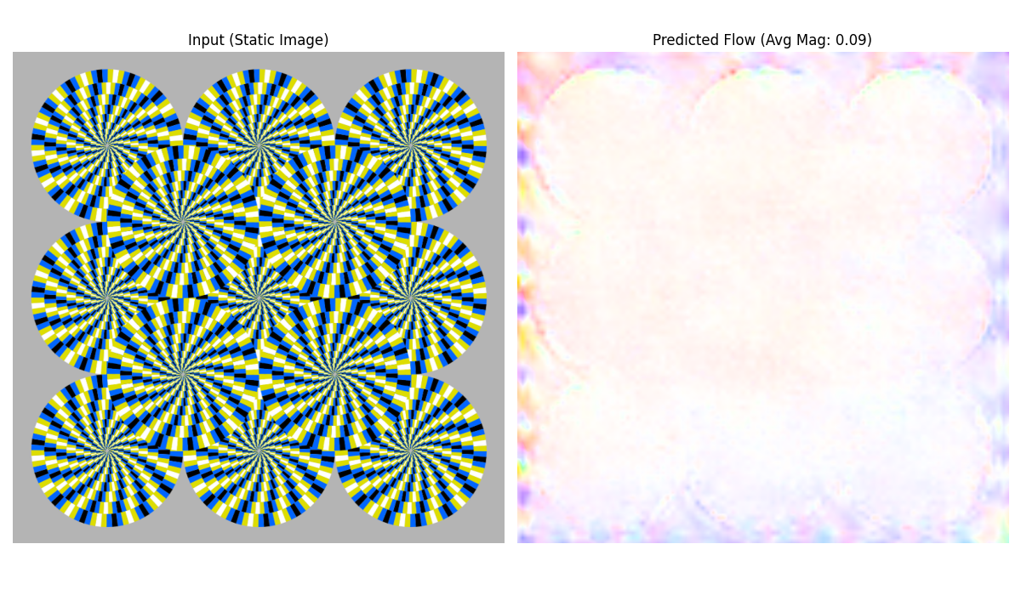
Test Case 1.2 :Colour Swapped Non Rotating Snake

Slide 6
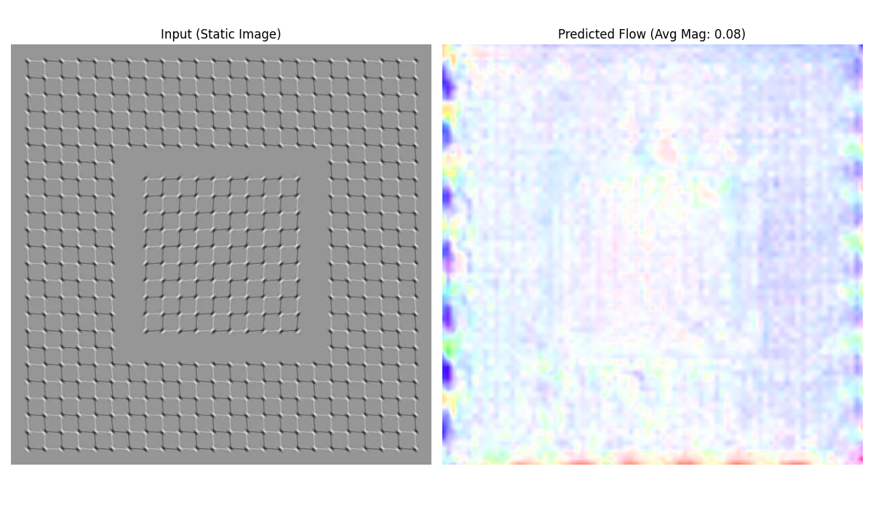
Test Case 1.3 : Drifting Emboss Illusion

Slide 7
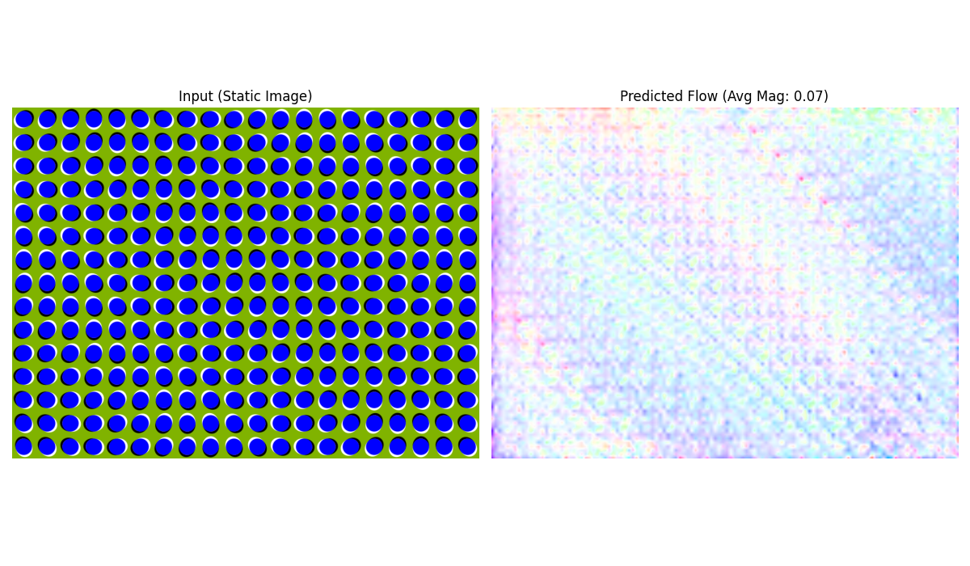
Test Case 1.4 : Anomalous Motion

Slide 8
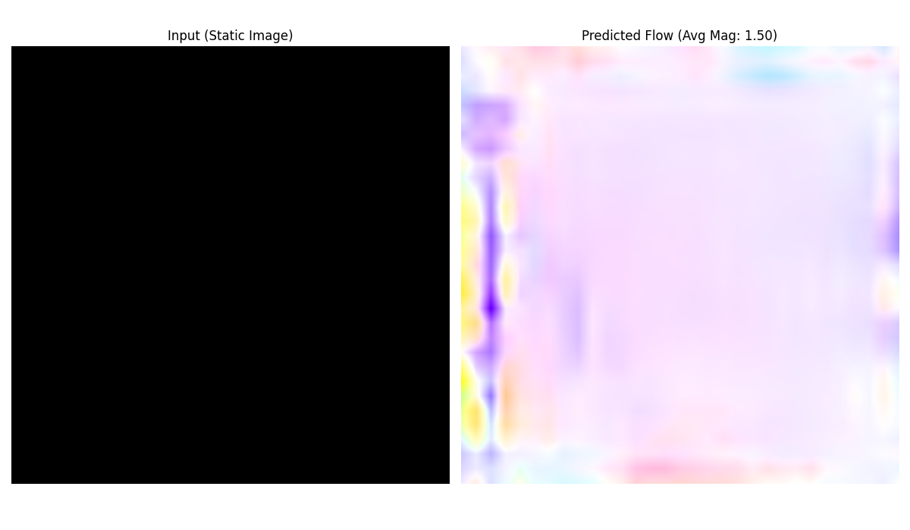
Test Case 1.5 : Pure Black Image

Slide 9
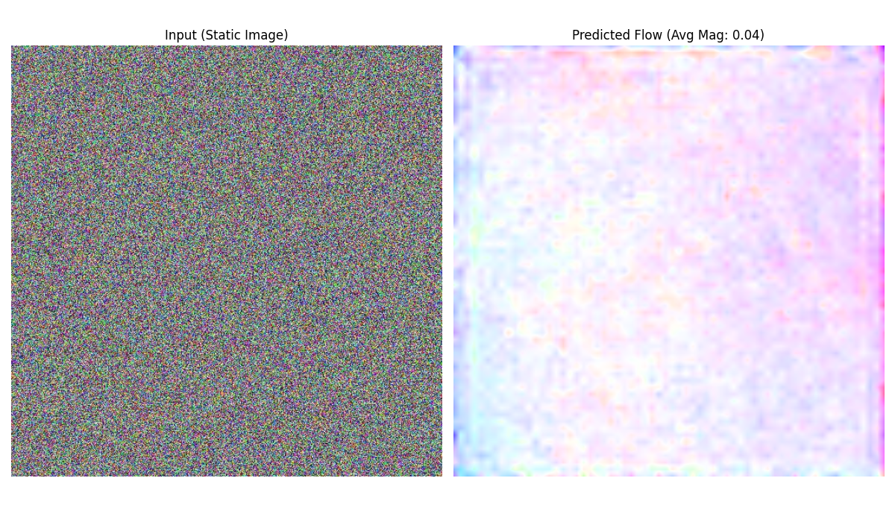
Test Case 1.6 : White Noise Image

Slide 10
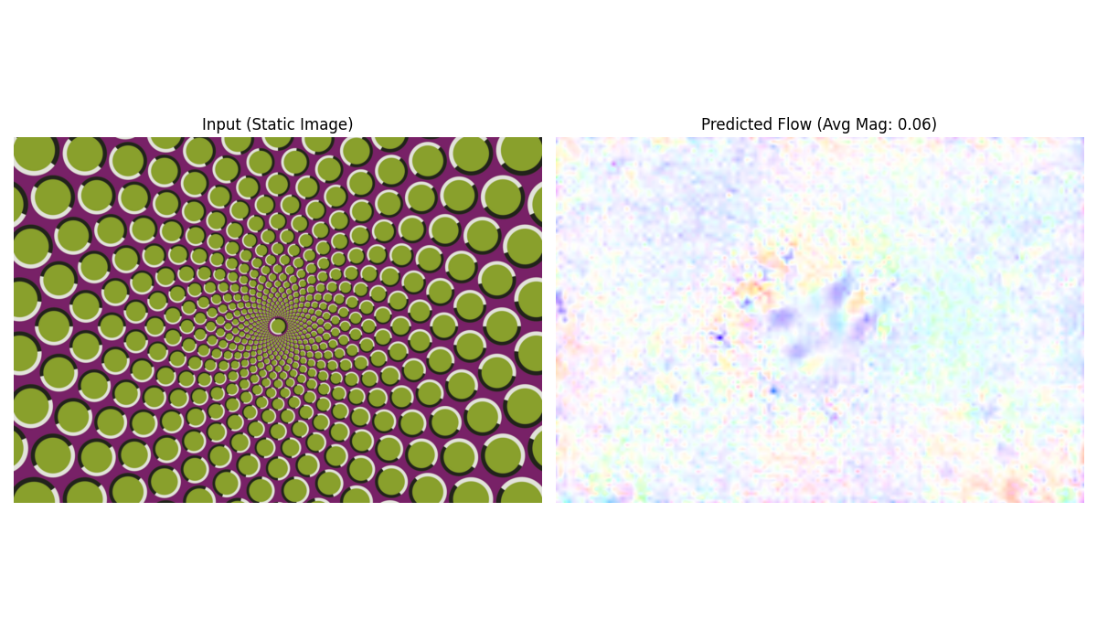
Test Case 1.7 : Repeated Pattern

Slide 11
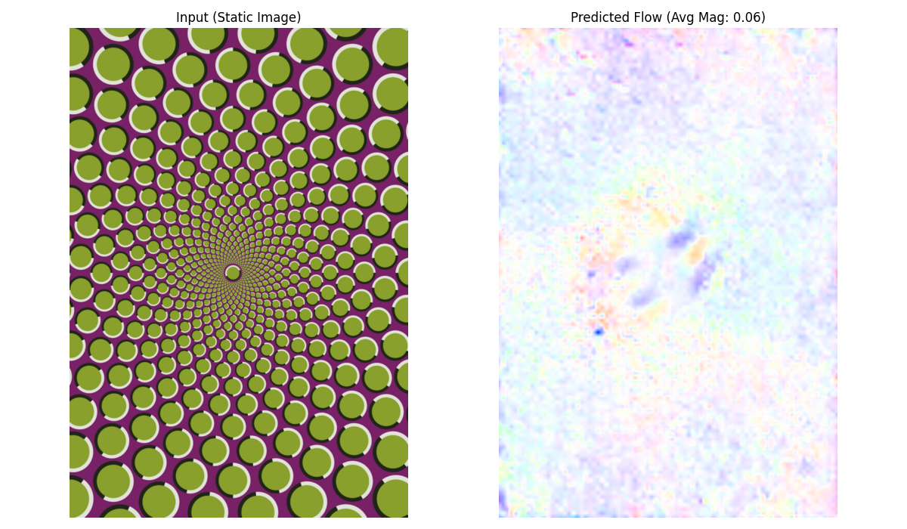
Test Case 1.8 : Repeated Pattern Rotated

Slide 12
Summary : Optical Flow with RAFT
In various illusion tests, RAFT yielded a near zero flow magnitude, the 0.04-0.09px movement is suspected due to texture less corner/borders in the first 3 test cases. Unlike PredNet model cited in the paper, RAFT did not hallucinate significant motion vectors in static gradient patterns.
In the pure black image the model exhibited significant random drift when comparing to white noise image
Rotating the illusion images by 90 degree did not result in corresponding rotating of flow vectors. The output remains negligible confirming the model was not reacting to the specific directional gradient of illusion.
RAFT demonstrates a high degree of mathematical robustness against illusions that fool human vision. However it fails when deprived of scenarios with texture less surfaces lacking spatial gradient resulting in hallucinating a drift.

Slide 13
2. Depth Estimation
We use DepthAnythingV2 currently considered the gold standard for depth estimation in the industry, we will attempt to investigate the following questions.
Q1 :Does the model interpret 2D forced-perspective art as physical geometry or a flat painted surface ?
Q2 :When presented with a mirror, does the model estimate depth to the glass surface or the virtual depth of the reflections?
Q3 :How does the model resolve the geometry of an Escher style object that cannot exist in 3D space?

Slide 14
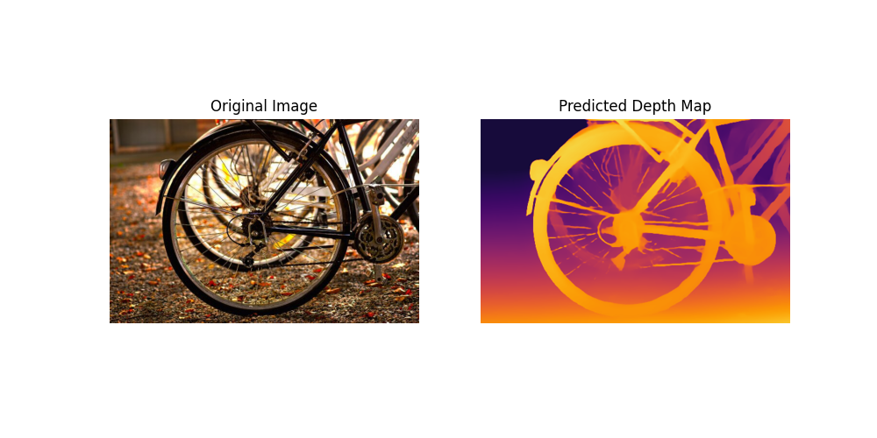
Verification of Local Implementation

Slide 15
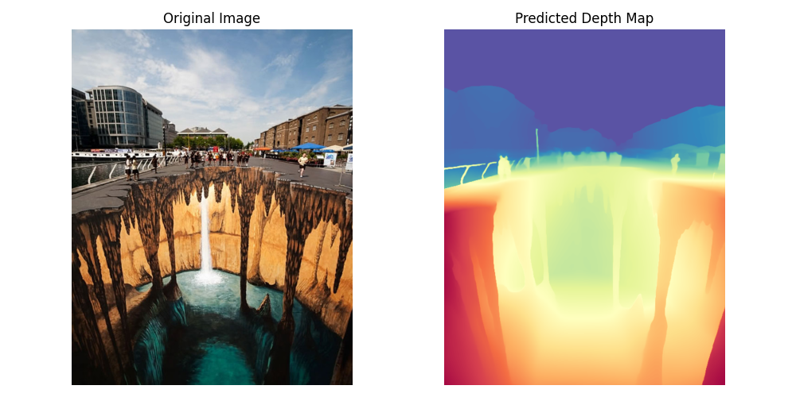
Test Case 2.1 : 3D Chalk Art

Slide 16
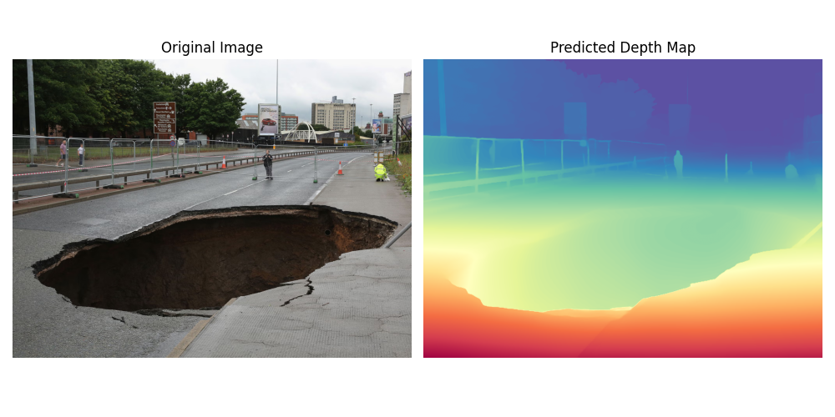
Test Case 2.2 : Real Sinkhole in Road

Slide 17
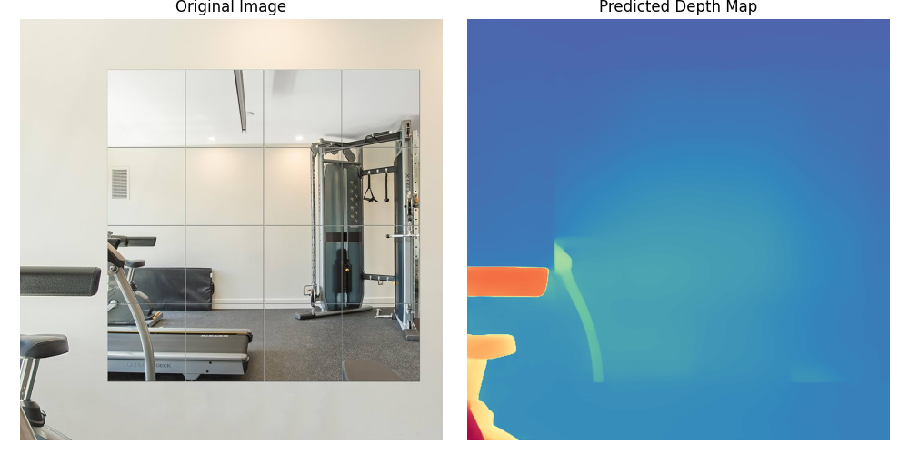
Test Case 2.3 : Mirror on the Wall

Slide 18
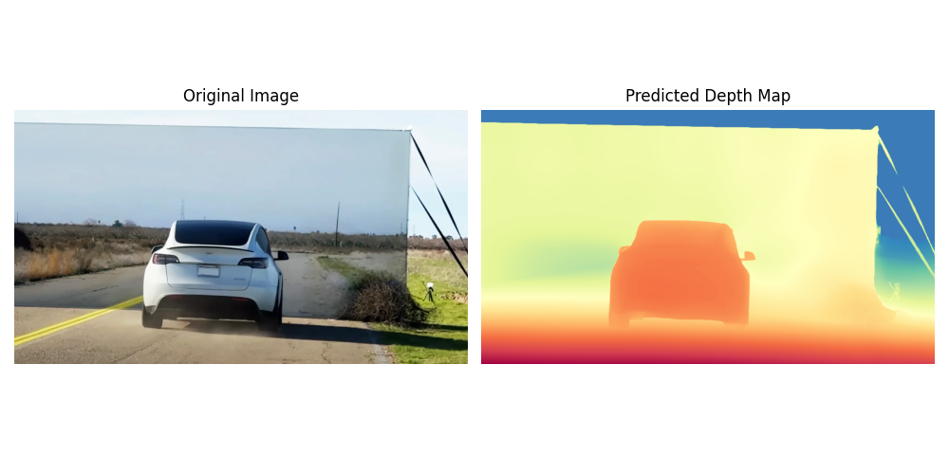
Test Case 2.4.1: Famous Tesla Wall Test

Slide 19
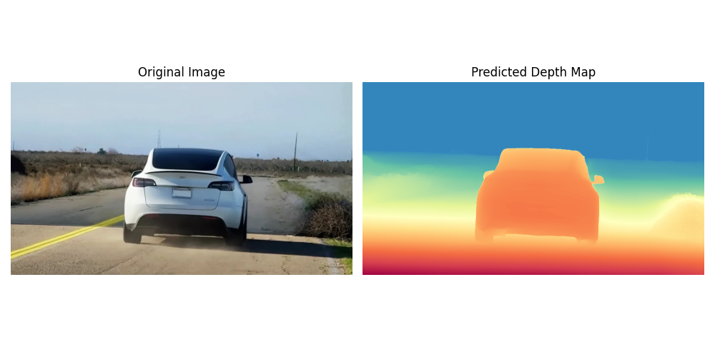
Test Case 2.4.2 : Tesla Wall Test Cropped

Slide 20
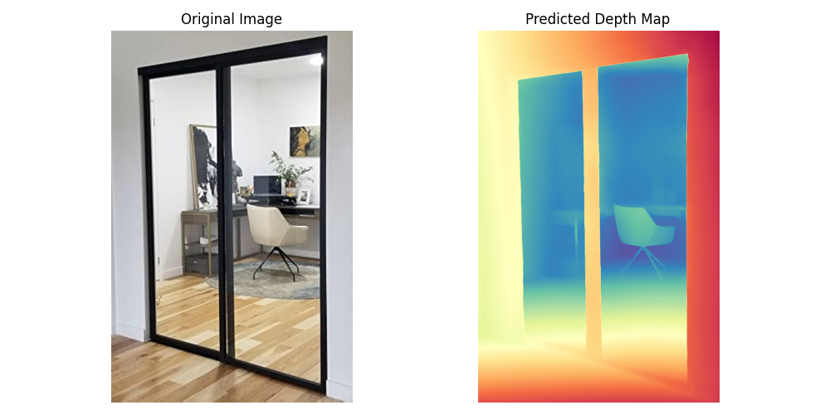
Test Case 2.5 : Transparent Glass Door

Slide 21
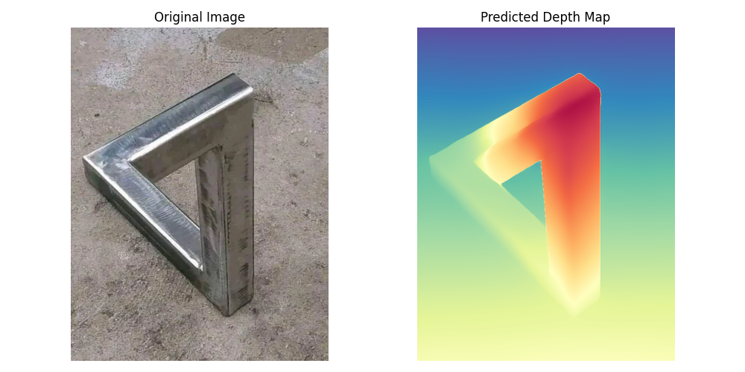
Test Case 2.6 : Penrose Triangle

Slide 22
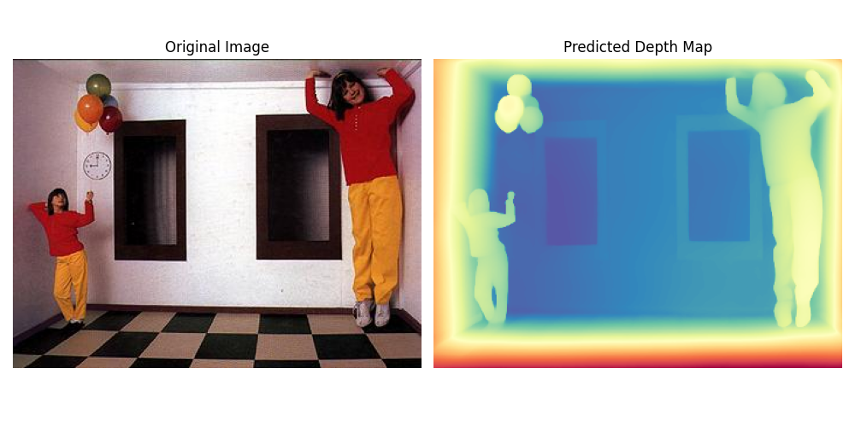
Test Case 2.7 : Ames Room

Slide 23
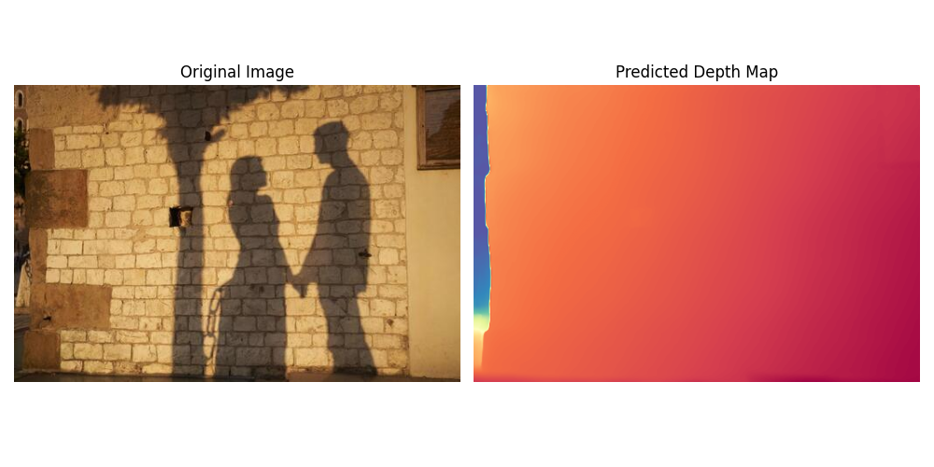
Test Case 2.8 : Shadow on Wall

Slide 24
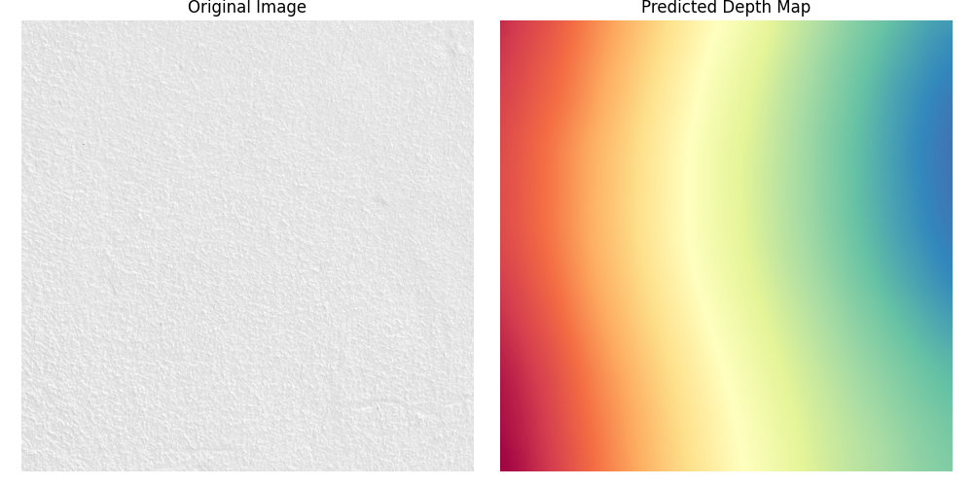
Test Case 2.9 : Flat White Wall

Slide 25
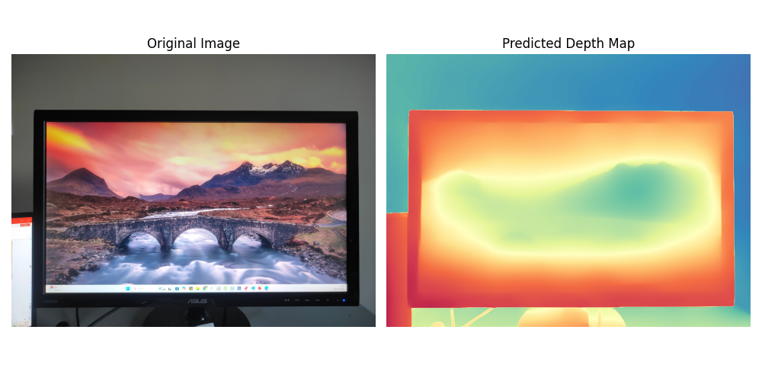
Test Case 2.10.1 : Screen with a Landscape

Slide 26
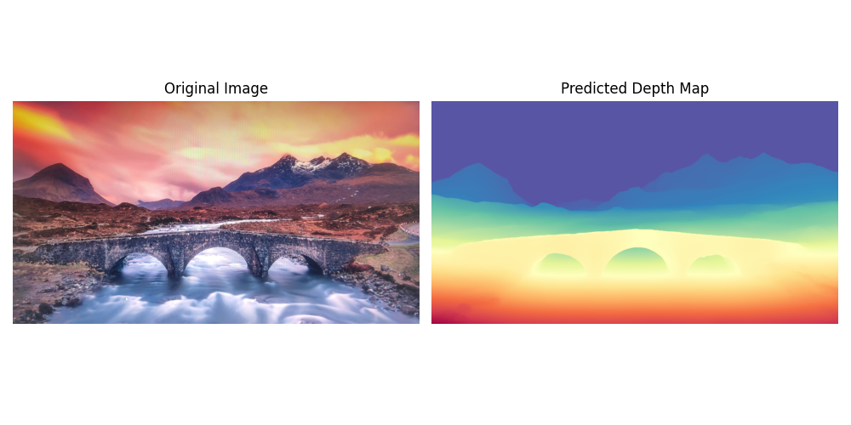
Test Case 2.10.2 :Screen with a Landscape Crop

Slide 27
Summary : Depth Estimation with DepthAnythingV2
The model consistently failed the Trompe-L’oeil test in flat street art.
Surprising the model did not fail in the mirror test and also partially passed the tesla wall test when give the whole image over cropped one showing that it takes various global elements in context, but it failed the transparent door.
The Penrose triangle was interesting with model forcing a broken 3D depth map and failing to detect the slanted floor in ames room.
The model also broken down on white flat wall.
The DepthAnythingV2 is strong model that is susceptible to forced perspective illusions which is risky for autonomous navigation.

Slide 28
3. Segmentation
We use SAM2 due to computational limits of my local implementation and there was not a significant difference observed between SAM2 vs SAM3 when comparing image only based segmentation (no text or prompt was provided to avoid bias of looking for a particular object) and the confidence was set to 25%, we will attempt to investigate the following questions.
Q1 :Does SAM2 demonstrate Gestalt principle of ‘Closure’ by segmenting objects defined only by missing information?
Q2 :Can SAM2 model group disconnected features into a single semantic entity eg. Dalmatian in spots?
Q3 :Does the model perceive an object occluded by a bar as one single object or two separate parts?

Slide 29
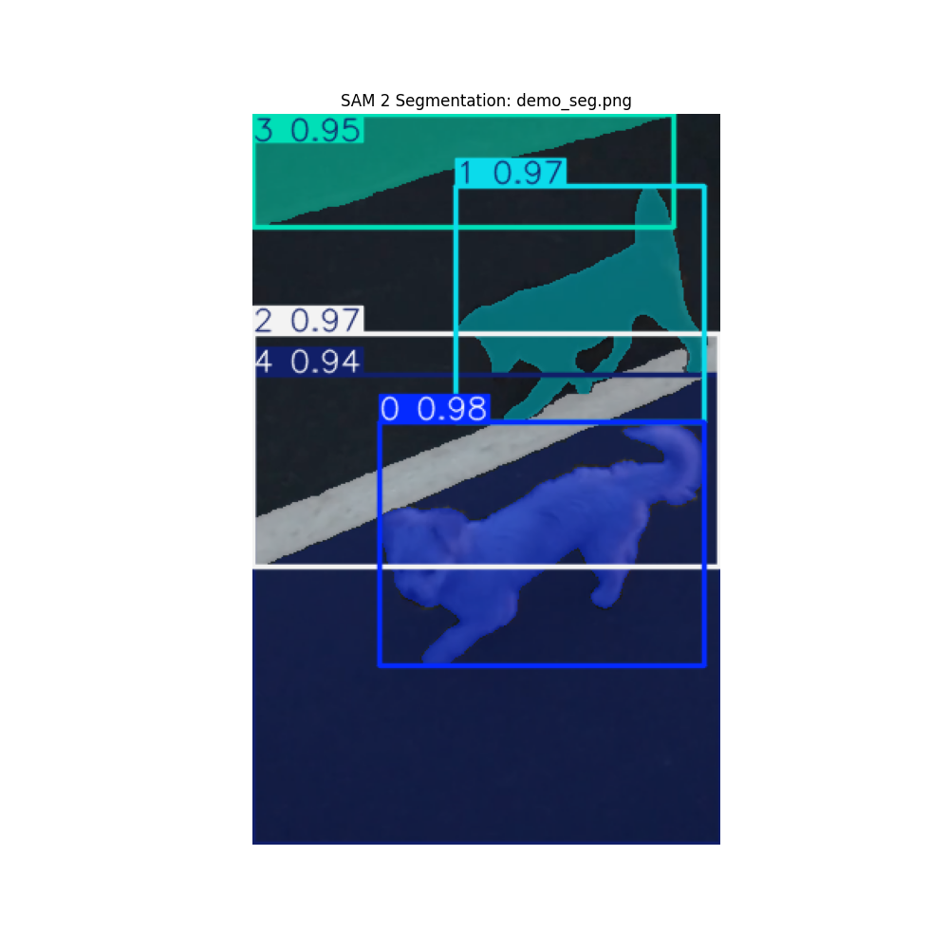
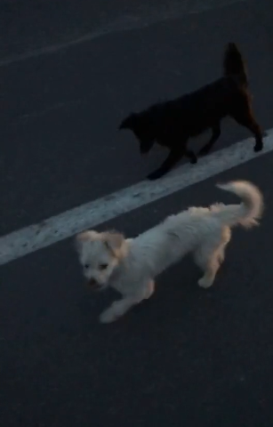
Verification of Local Implementation

Slide 30
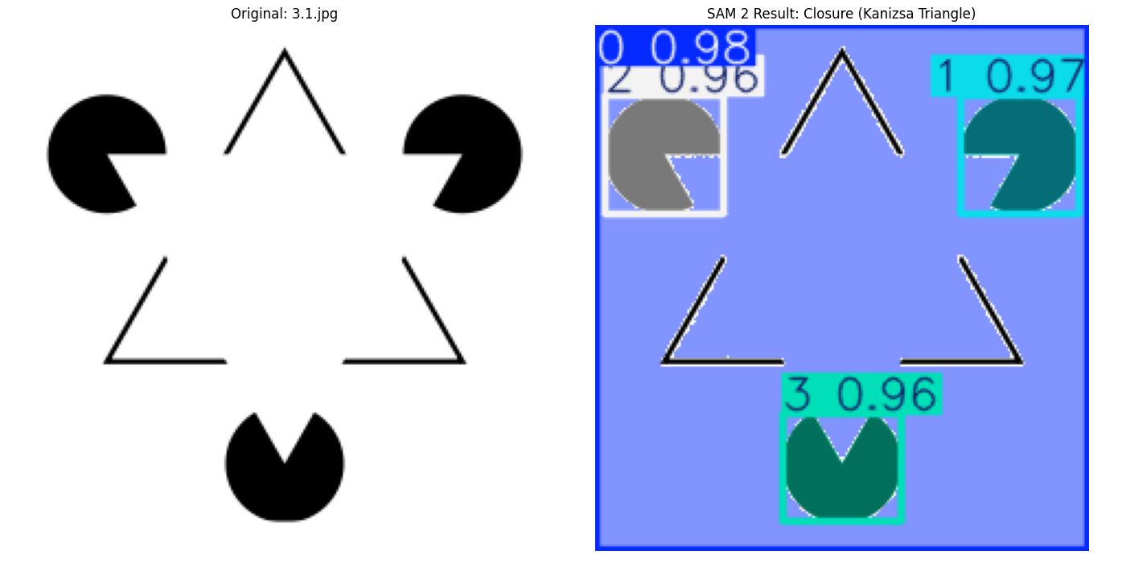
Test Case 3.1 : Kanizsa Triangle

Slide 31
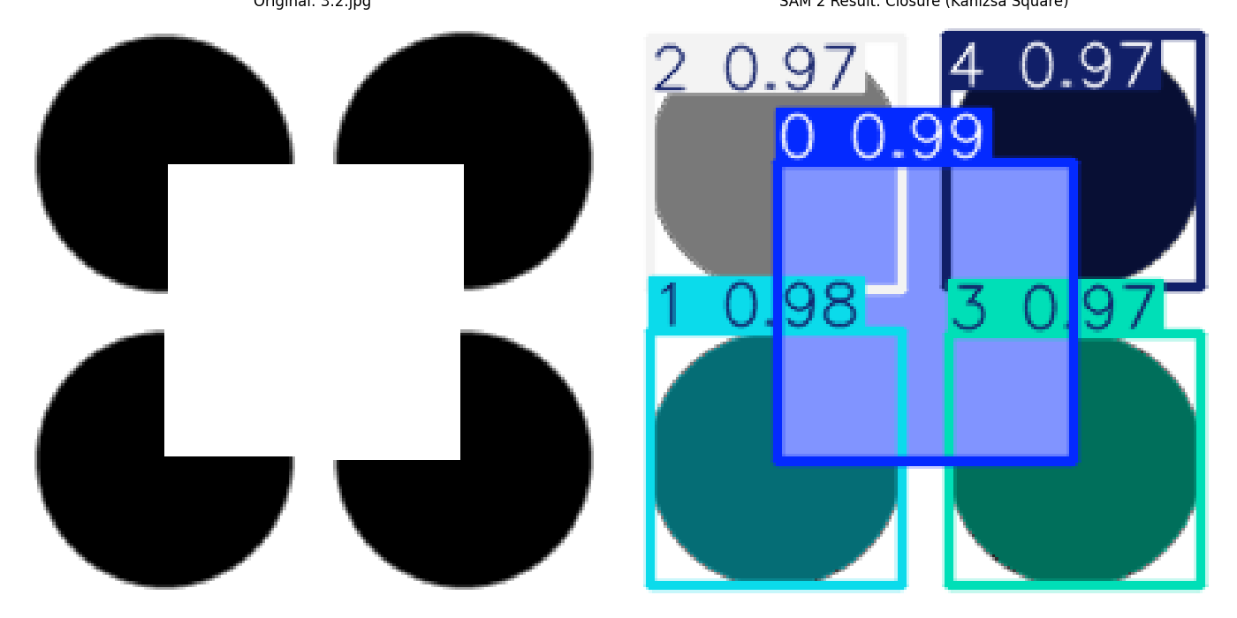
Test Case 3.2 : Kanizsa Square

Slide 32
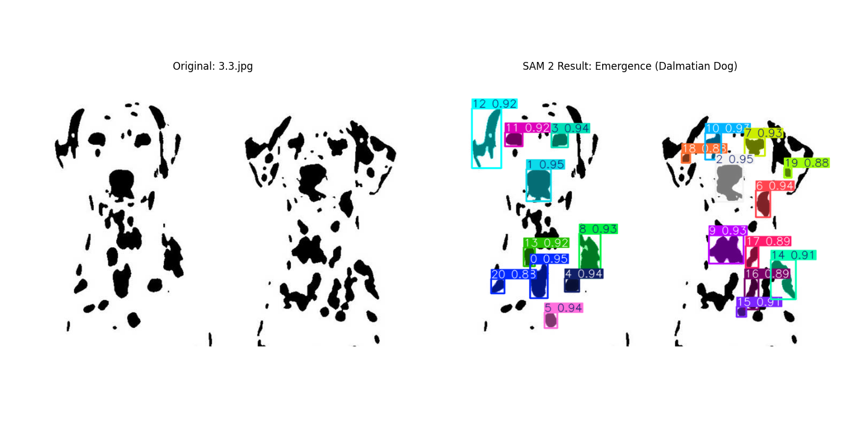
Test Case 3.3 : Dalmatian

Slide 33
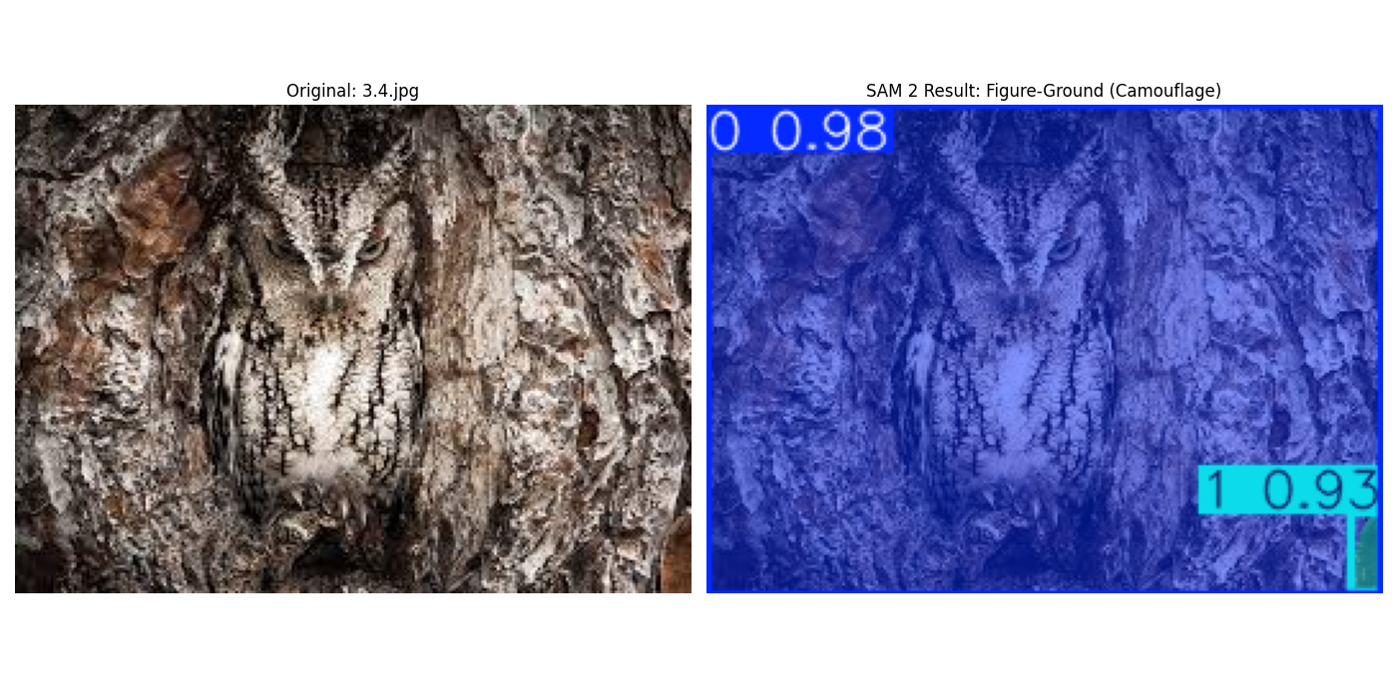
Test Case 3.4 : Tree Owl

Slide 34
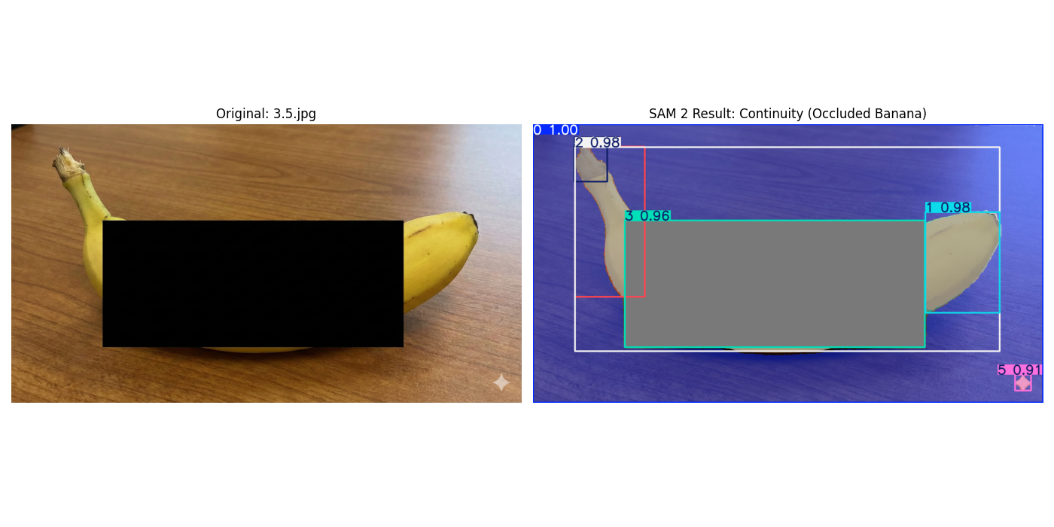
Test Case 3.5 : Occluded Banana

Slide 35
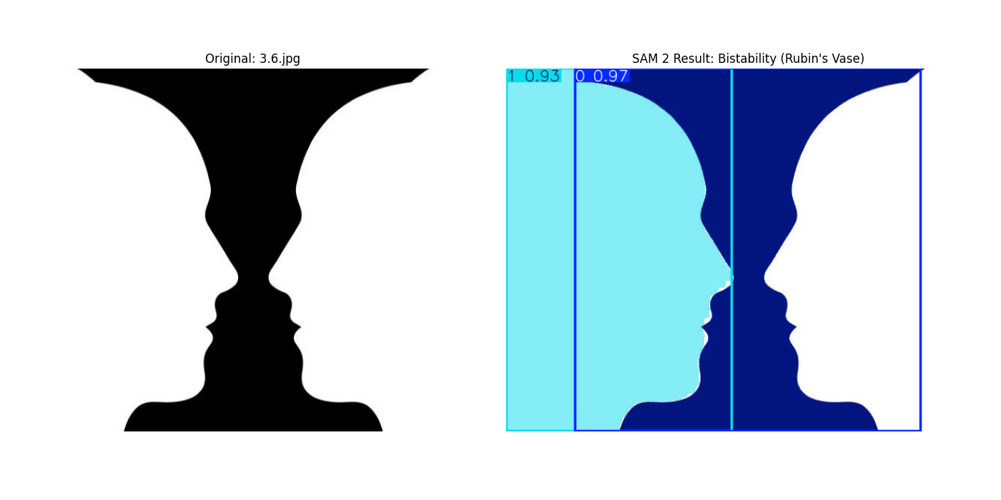
Test Case 3.6 : Rubin Vase

Slide 36
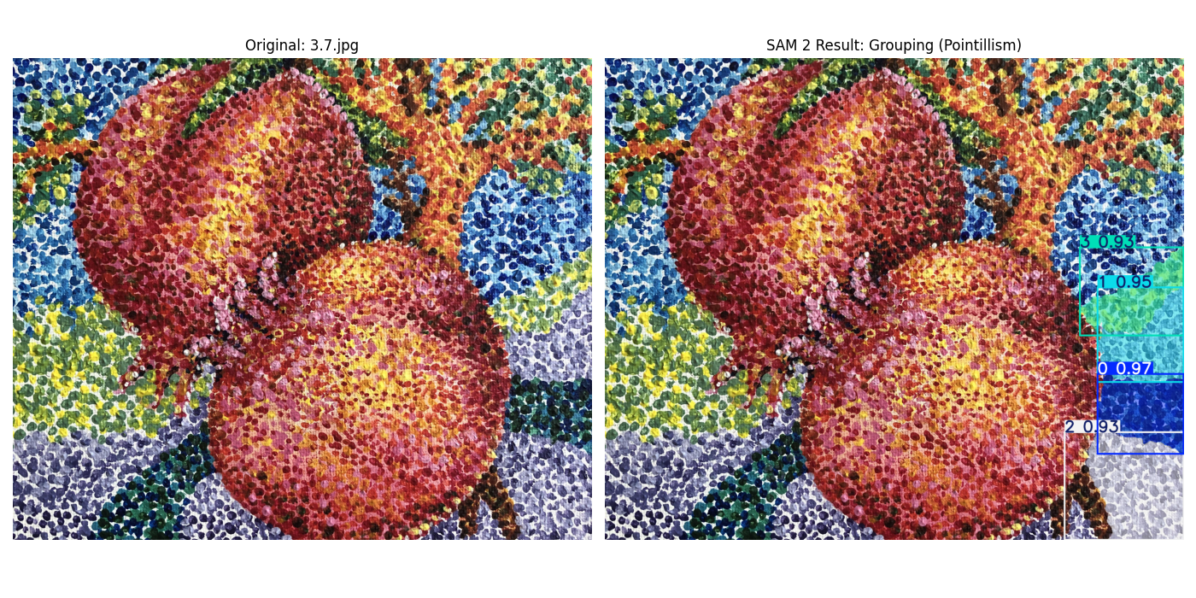
Test Case 3.7 : Point Painting

Slide 37
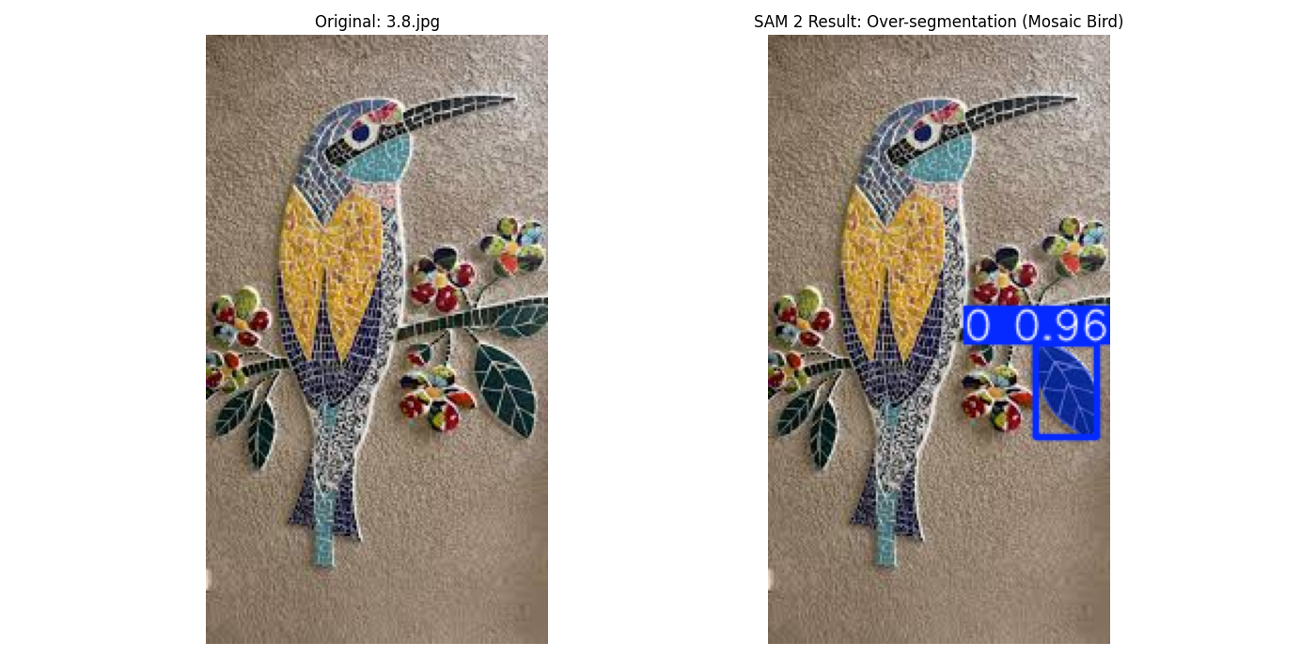
Test Case 3.8 : Mosaic Bird

Slide 38
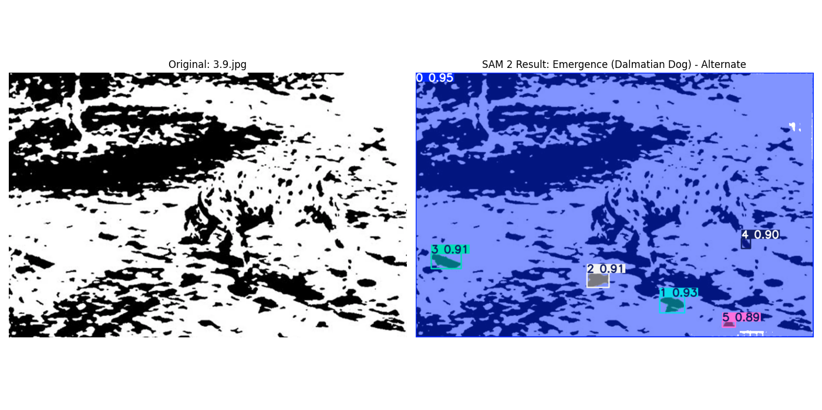
Test Case 3.9 : Dalmatian Dog

Slide 39
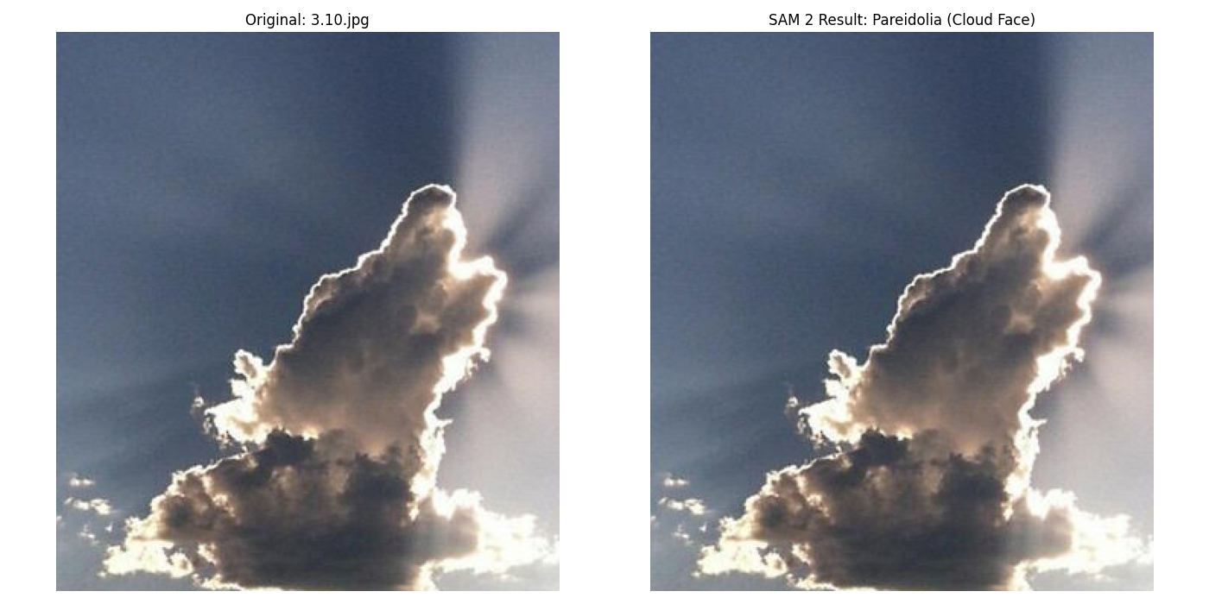
Test Case 3.10 : Cloud Face

Slide 40
Summary : Segmentation with SAM2
SAM2 Failed to segment Kanizsa triangle but was successful in the square case.
The occlusion tests made the model think objects were different parts and detected it as fragmented instead of a single object.
All the other high noise scenarios of dalmatian dogs, mosaic bird or the points painting SAM2 struggled and failed to group spots. Showing it requires text based prompts for understanding.
SAM2 shows geometric intelligence but has difficulty with semantic reasoning.
The results can slightly differ since a tiny model was used with less parameters over a larger model.

Slide 41
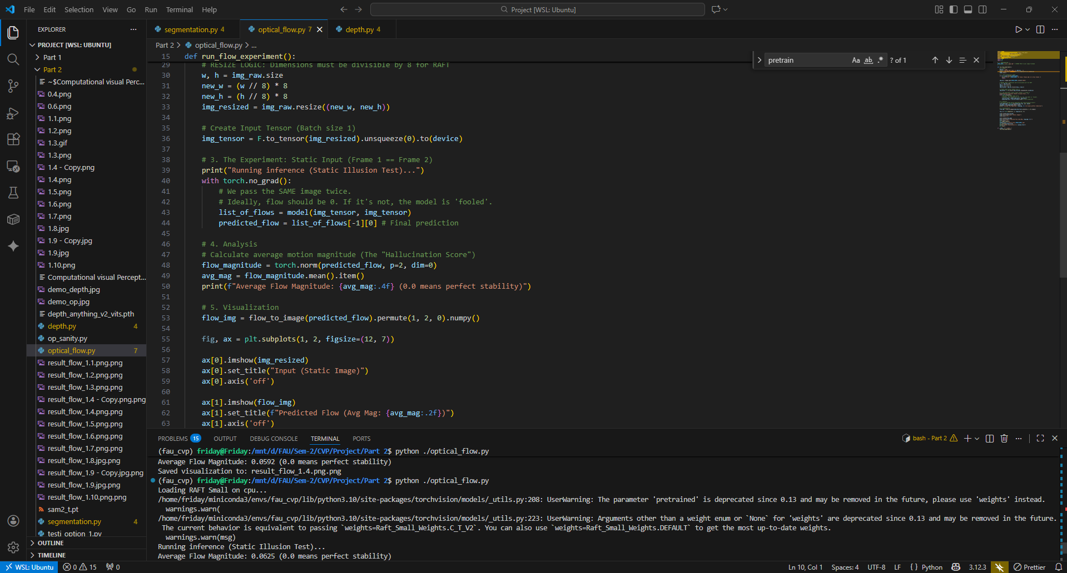
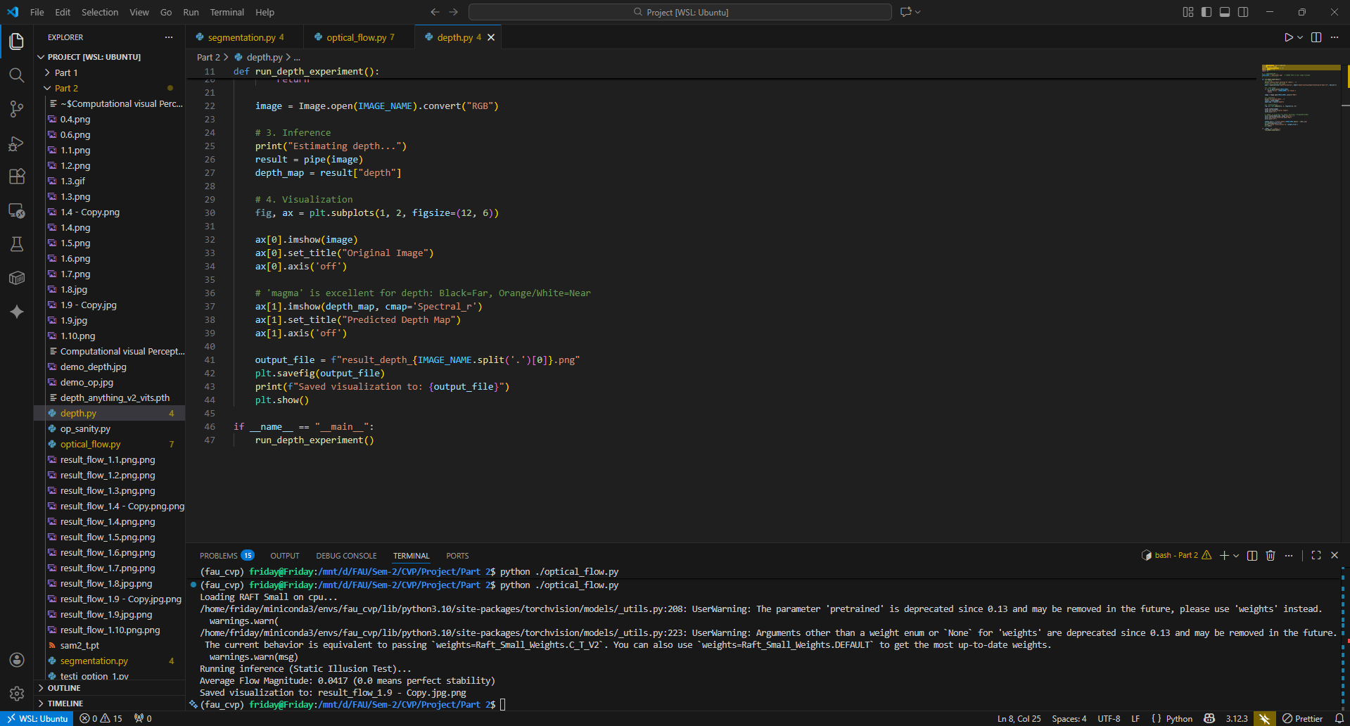
Local Implementation All the scripts and images can be found on my repo : https://github.com/code-barrage/FAU_CVP_Project-WiSo25-26

Slide 42
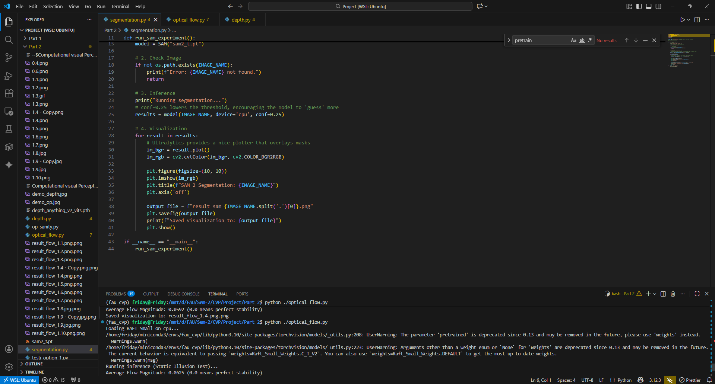

Slide 43
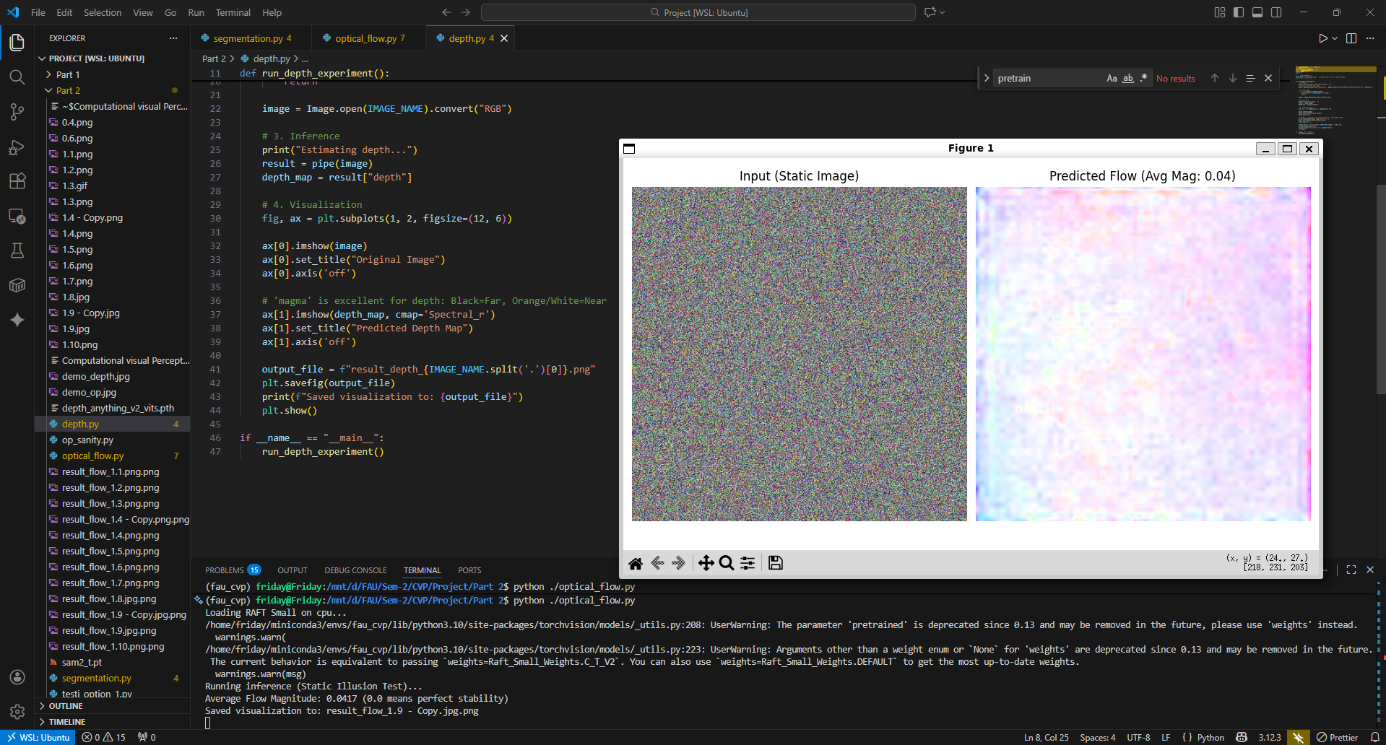

Slide 44
References and Courtesy
https://www.ecva.net/papers/eccv_2020/papers_ECCV/papers/123470392.pdf
https://michaelbach.de/ot/mot-snakesLum/
https://journals.sagepub.com/doi/10.1177/20416695211018720
https://www.psy.ritsumei.ac.jp/akitaoka/saishin57e.html
https://www.reddit.com/r/illusionporn/comments/1ptwxbq/a_ceiling_art_that_looks_like_moving/?utm_source=share&utm_medium=web3x&utm_name=web3xcss&utm_term=1&utm_content=share_button

